Slide 1
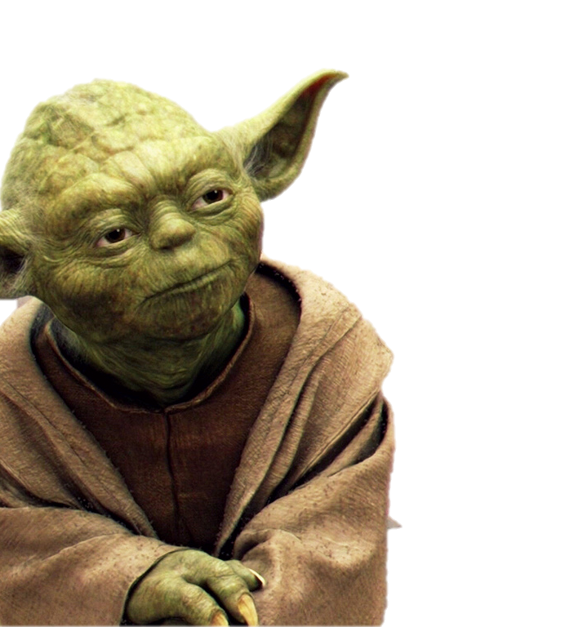
Active and passive
Learn it you must.

Slide 2
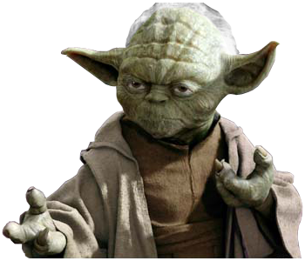
ACTIVE VOICE
Sentence
Subject
Luke Skywalker
Verb
switches on
Object
the lightsaber

Slide 3
PASSIVE VOICE
Sentence
Object
The lightsaber
Verb
Is switched on
Subject
by Luke Skywalker

Slide 4
Active to passive
General rule
Underline the verb.
Divide the sentence into: subject; verb; object.
Begin with the object.
Example:
Obi-Wan Kenobi congratulates Luke Skywalker.  Luke Skywalker is congratulated by Obi-Wan Kenobi.

Slide 5
Active to passive
General rule
Identify the tense and keep to it.
Use the most basic form of the tense.
Add the past participle (3rd column of the verb)
Example:
A: Han Solo fixes the ship.
P: The ship is fixed by Han Solo.

Slide 6
Active to passive
Pronouns
Change pronouns from the subject form to the object form.
Example:
He/they fought the sith.  The sith was fought by him/them.

Slide 7
Active to passive
Pronouns
 | SINGULAR |  | PLURAL
 | Subject | Object | Subject | Object
1st person | I | me | we | us
2nd person | you | you | you | you
3rd person | he/she/it | him/her/it | they | them

Slide 8
Active to passive
Pronouns
In some sentences, the agent (doer) is not mentioned:
When it can be understood without it and it would be clumsy to mention it.
Especially true when the agent is a pronoun.
We keep our lightsabers here.  Our lightsabers are kept here. (by us)
They will take a decision soon. A decision will be taken soon. (by them)

Slide 9
Active to passive
Commands
Be prepared by Tuesday!  You must be prepared by Tuesday.

Slide 10
Active to passive
Questions
Who stole the ship?  By whom was the ship stolen?

Slide 11
Effective use of the passive voice
It is more natural to use the active voice, but the passive voice is sometimes used for effect.
When it not necessary to mention the subject (doer).
e.g. Refreshments will be served.
When we are not sure who did the action.
e.g. The princess was kidnapped.
When demands are made anonymously.
e.g. Flying is not permitted in the station.
When a nameless accusation is made.
e.g. This chip has been damaged during the flight.

